Slide 1



HOME
AUTOMATION
USING IOT
6 Credits
Project ID – W27

Slide 2




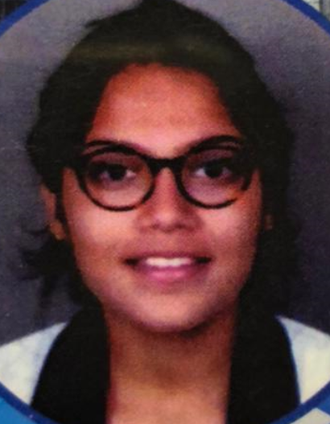
TEAM COMPOSITION
ROHAN N KALPAVRUKSHA | PES1201802830
ROSHAN N KALPAVRUKSHA | PES1201802834
AKHIL V NAYANEGALI | PES1201801945
MRIDHULA SRIHARSHA | PES1201801122
GUIDE - Dr. Anuradha M
Professor and Chairperson, ECE Department

Slide 3
CONTENTS
Introduction
Problem Statement
Block Diagram
Implementation progress
Deliverables
References
Project timeline Gantt Chart

Slide 4
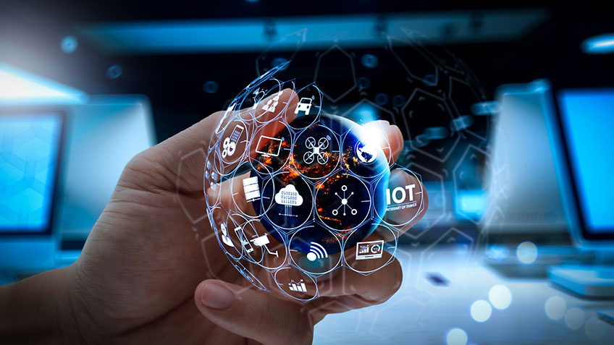
INTRODUCTION
Home Automation :
Automatically performs everyday functions around the home
Saves time, energy, money and provides security.
Internet of Things (IOT) :
Network of embedded objects
Connects and exchanges data with other devices over the internet.

Slide 5
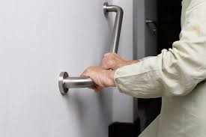
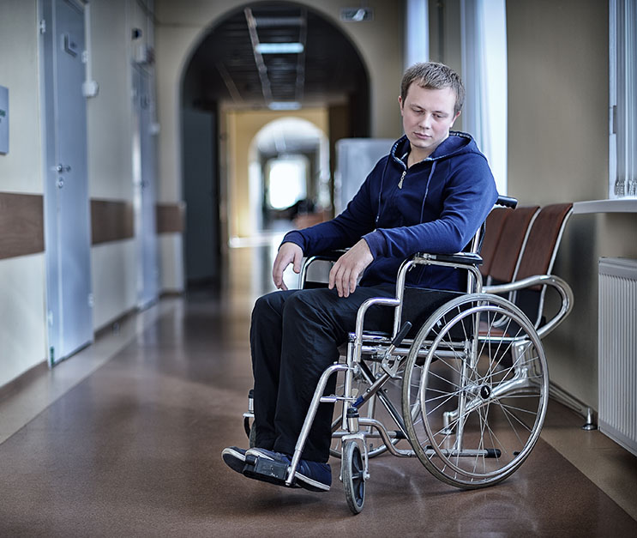
PROBLEM STATEMENT
Brain-numbing task to walk out from our place to control various electric devices
Motivation : Make it self-regulating for physically handicapped and old aged people.
Develop a wrist band to control devices.
Relatively affordable, simple to implement and users friendly.

Slide 6
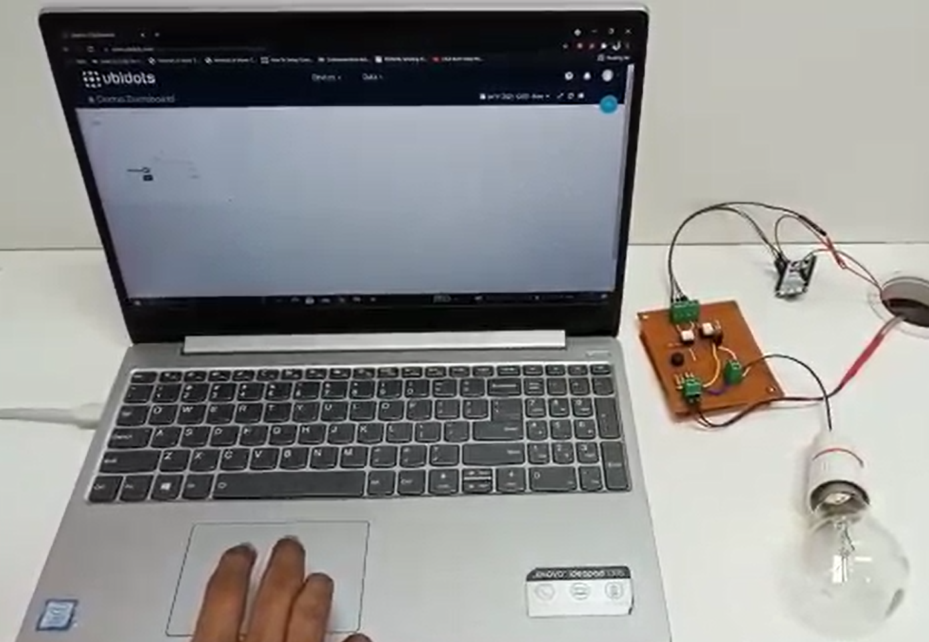
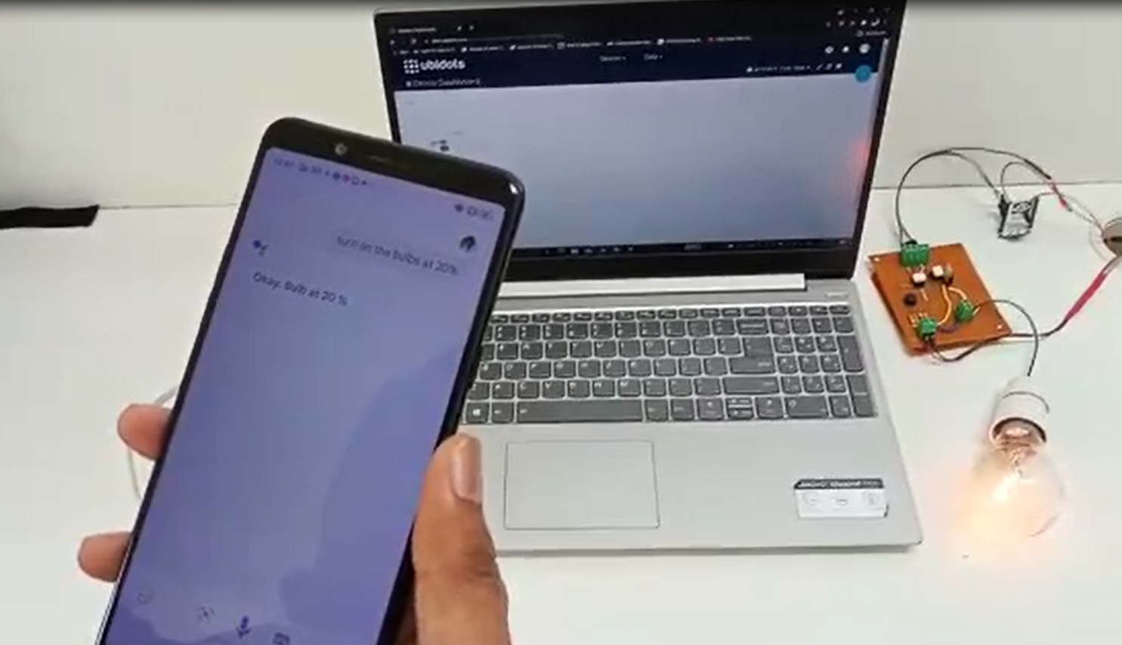
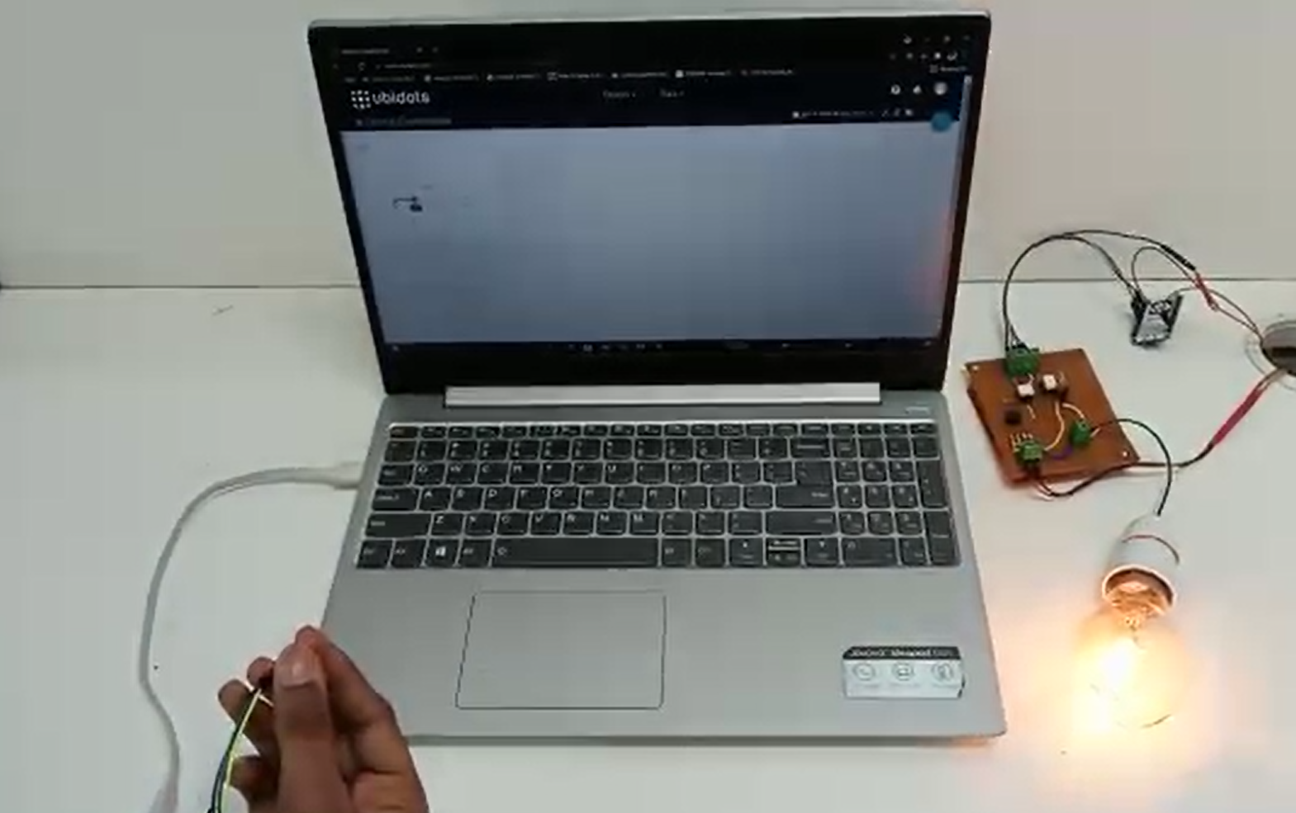
IMPLEMENTATION PROGRESS
We have tried to implement the controlling of intensity of bulb with the help of our gesture, voice, slide bar and integrate all three methods.

Slide 7
BLOCK DIAGRAM
ONLINE DASHBOARD
CLOUD
CONTROL APP
CONTROL DEVICE
(SMART WATCH)
Slide Bar
Wi-Fi
Module
Speech Sensors
Levels Altered
Arduino IDE
Node MCU
LIGHT
FAN

Slide 8
BLOCK DIAGRAM
(SMART WATCH)
Node MCU
Publisher
Publish
MQTT Broker
Subscribe
Node MCU
Subscriber
Accelerometer
Google
Assistant
WI-FI
LIGHT
FAN
Senses Gesture
Senses Voice
Slide Bar
Senses Movement

Slide 9
ADVANTAGES OF MQTT
Distribute information more efficiently.
Reduce update rates to seconds.
Very well-suited for remote sensing and control.
Maximize available bandwidth.
Extremely lightweight overhead
Increase scalability.
The real advantage of MQTT over HTTP occurs when we reuse the single connection for sending multiple messages in which the average response per message converges to around 40 ms and the data amount per message converges to around 400 bytes.

Slide 10

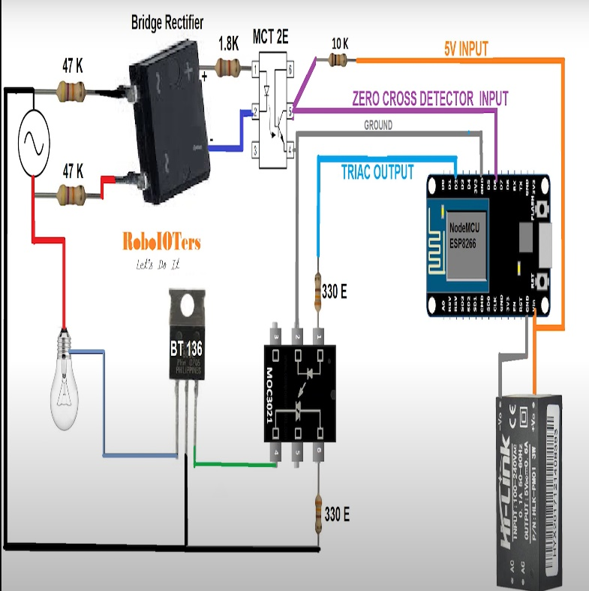
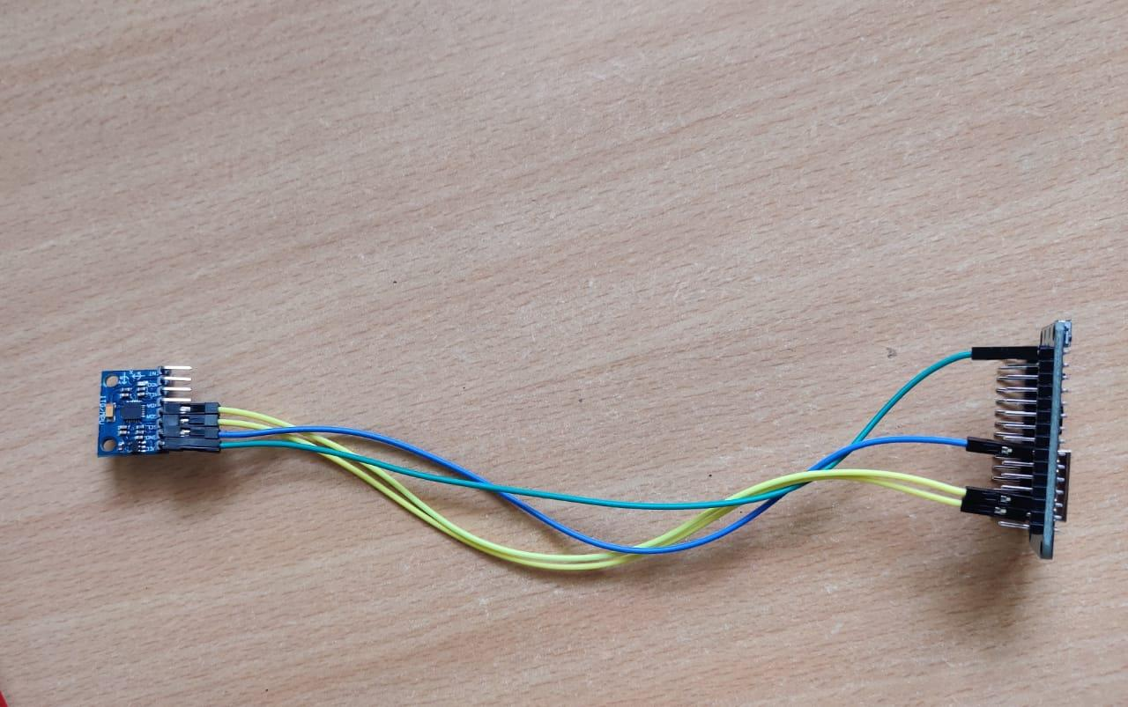
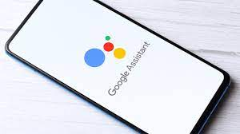
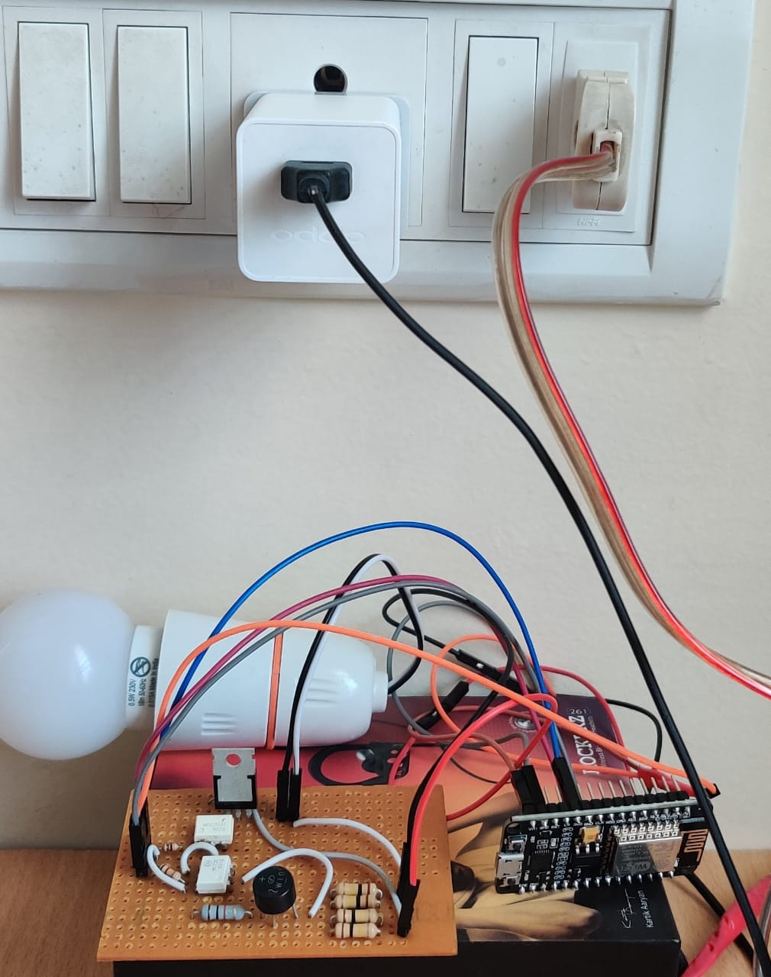
CIRCUIT
SETUP NEAR BULB
SETUP NEAR
SMART WATCH

Slide 11


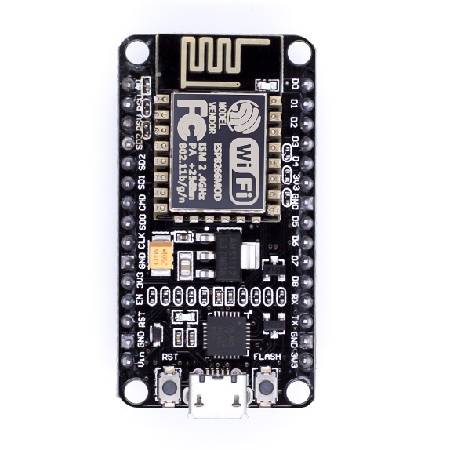

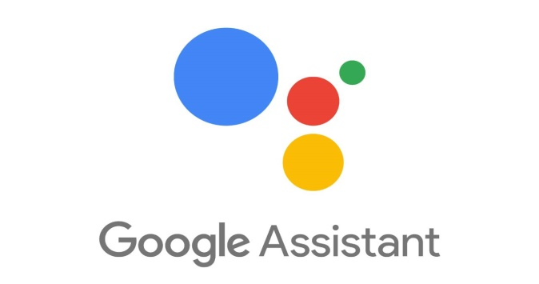
VOICE CONTROL
Hey Google, Turn on Bulb at 30 %

Slide 12
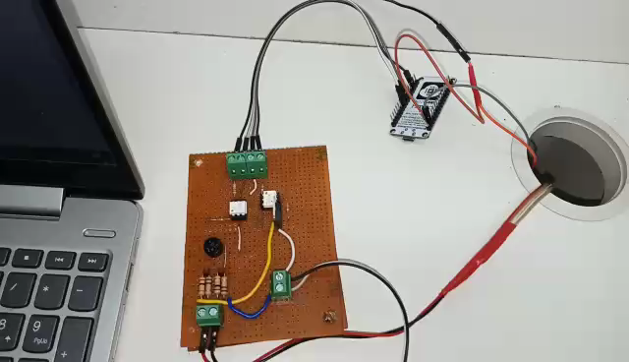
VIDEO

Slide 13
DELIVERABLES
Phase 1
Controlling of led through a Slide Bar using Blynk App
Phase 2
A smart Wristband to control the functions of the
light bulb and fan through slide bar, voice and gesture.
Technical paper writing.

Slide 14
REFERENCES
[1]Assad Mohammed , Amar Seeam , Xavier Bellekens z, Kamila Nieradzinska x, Visham Ramsurrun , “Gesture based IoT Light Control for Smart Clothing” , 2016 IEEE International Conference on Emerging Technologies and Innovative Business Practices for the Transformation of Societies (EmergiTech), Avaliable online: 10.1109/EmergiTech.2016.7737326
[2] Sajid Nagarboudi Patel a, R.D.Salagarb ,”A Review on Iot Light Control for Smart Clothing using Gesture Control”
International Journal of Innovative and Emerging Research in Engineering Volume 4, Issue 6, 2017.
[3] Yash Govilkar, Dr. Rupesh Jaiswal , “A Gesture Based Home Automation System” , International Journal for Research in Applied Science & Engineering Technology (IJRASET), Volume 7 Issue XI, Nov 2019, Available online: http://doi.org/10.22214/ijraset.2019.11081
[4] Osheen Bindroo, Komal Saxena, Sunil Kumar Khatri, “A Wearable NFC Wristband for Remote Home Automation System”, 2017 2nd International Conference on Telecommunication and Networks (TEL-NET), Available Online :10.1109/TEL-NET.2017.8343563
[5] Ravi Kishore Kodali, Borra Yatish Krishna Yogi, Gudibanda Nagesh Sharan Sai, Jehova Honey Domma, “Implementation of Home Automation Using CoAP”, 28-31 Oct. 2018 TENCON 2018 - 2018 IEEE Region 10 Conference
[6] Kamelya Dehghani Kohnehshahri, Mohammad Hasan Kargar, Fatemeh Soleimani-Roozbahani, “The Effect of Using COAP Protocol on Reducing Energy Consumption in Smart Houses”, Sep 8, 2018 Int. J. Advanced Networking and Applications Volume: 10Issue: 03Pages: 3843-3852 (2018) ISSN: 0975-0290

Slide 15
PROJECT TIMELINE (PHASE 2)
SCHEDULE | JUNE | JULY | AUGUST | SEPTEMBER
IMPLEMENTATION OF ALGORITHM TO DETECT THE GESTURE
DEVELOPMENT OF GESTURE DETECTION SYSTEM
INTEGRATE ALL THREE TECHNIQUE TO CONTROL BULB
IMPLEMENTING THE CIRCUIT FOR FAN & DESIGN OF THE WRISTBAND
FINAL REPORT AND TECHNICAL PAPER WRITING

Slide 16
THANK YOU

